Slide 1
Ensemble Learning
When you want to purchase a new car, will you walk up to the first car shop and purchase one based on the advice of the dealer? It’s highly unlikely.
You would likely browser a few web portals where people have posted their reviews and compare different car models, checking for their features and prices. You will also probably ask your friends and colleagues for their opinion. In short, you wouldn’t directly reach a conclusion, but will instead make a decision considering the opinions of other people as well.
Ensemble models in machine learning operate on a similar idea. They combine the decisions from multiple models to improve the overall performance. The objective of this article is to introduce the concept of ensemble learning and understand the algorithms which use this technique.

Slide 2
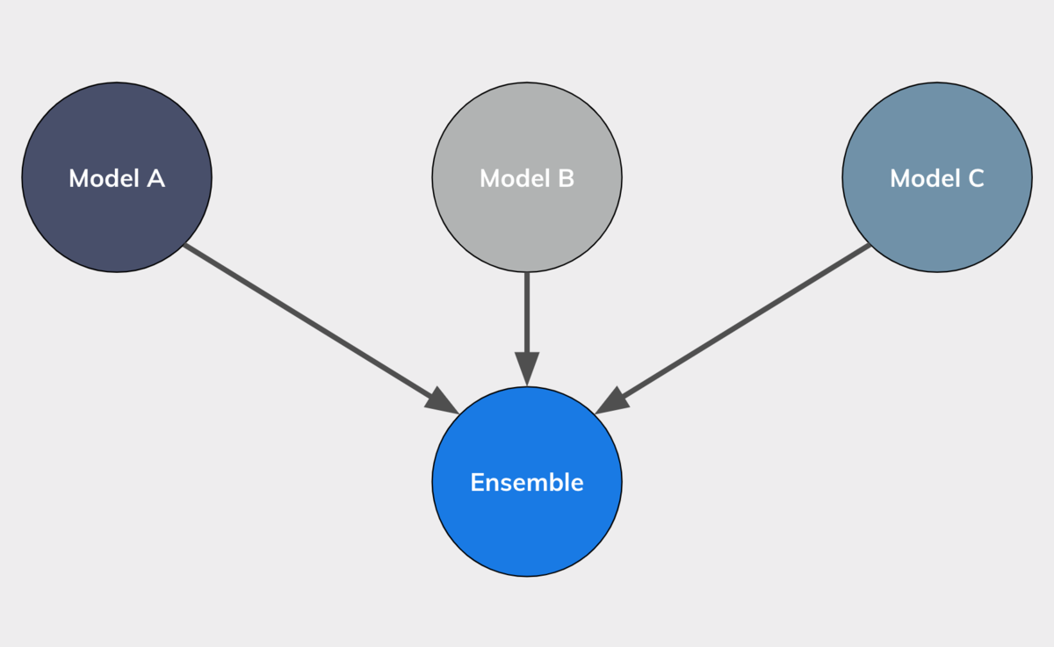

Slide 3
Simple Ensemble Techniques
We will look at a few simple but powerful techniques, namely:
Max Voting
Averaging
Weighted Averaging

Slide 4
Max Voting
The max voting method is generally used for classification problems. In this technique, multiple models are used to make predictions for each data point. The predictions by each model are considered as a ‘vote’. The predictions which we get from the majority of the models are used as the final prediction.
For example, when you asked 5 of your colleagues to rate your movie (out of 5); we’ll assume three of them rated it as 4 while two of them gave it a 5. Since the majority gave a rating of 4, the final rating will be taken as 4. You can consider this as taking the model of all the predictions.
The result of max voting would be something like this:
Colleague 1 | Colleague 2 | Colleague 3 | Colleague 4 | Colleague 5 | Final rating
5 | 4 | 5 | 4 | 4 | 4

Slide 5
Averaging
Similar to the max voting technique, multiple predictions are made for each data point in averaging. In this method, we take an average of predictions from all the models and use it to make the final prediction. Averaging can be used for making predictions in regression problems or while calculating probabilities for classification problems.
For example, in the below case, the averaging method would take the average of all the values. i.e. (5+4+5+4+4)/5 = 4.4
Colleague 1 | Colleague 2 | Colleague 3 | Colleague 4 | Colleague 5 | Final rating
5 | 4 | 5 | 4 | 4 | 4.4

Slide 6
Weighted Average
This is an extension of the averaging method. All models are assigned different weights defining the importance of each model for prediction. For instance, if two of your colleagues are critics, while others have no prior experience in this field, then the answers by these two friends are given more importance as compared to the other people.
The result is calculated as [(5*0.23) + (4*0.23) + (5*0.18) + (4*0.18) + (4*0.18)] = 4.41
Colleague 1 | Colleague 2 | Colleague 3 | Colleague 4 | Colleague 5 | Final rating
weight | 0.23 | 0.23 | 0.18 | 0.18 | 0.18
rating | 5 | 4 | 5 | 4 | 4 | 4.41

Slide 7
Another example on weighted average technique - Car example, if I know that a person has more knowledge about cars, I would like to give his or her recommendation a higher rate. So coming back, let’s say that these three models M1, M2, and M3 have an R-square on validation of 0.6, 0.4, and 0.7 respectively.
So what does this mean? This means that M2 is not performing great as compared to M1 and M3. So M3 is my best model. And M2 is my worst model.
Now, if I have to somehow combine them more intelligently, what I can do is I can give them some sort of weights and these weights would be representative of how much weight do I give to their predictions, since in this particular case, my model M2 is not the best model, I’ll give it a lower weight whereas M1 and m3 are better models. I’ll give them higher weights. So let’s give them the following weights-

Slide 8
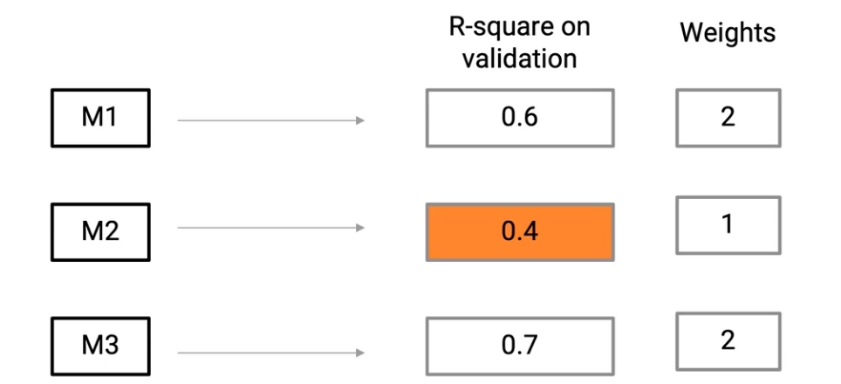
What I would do now is I’ll basically multiply these weights to individual predictions and then take their mean. So M1 predictions which are, 3900, 390, etc, we’ll multiply them by a factor of 2-

Slide 9
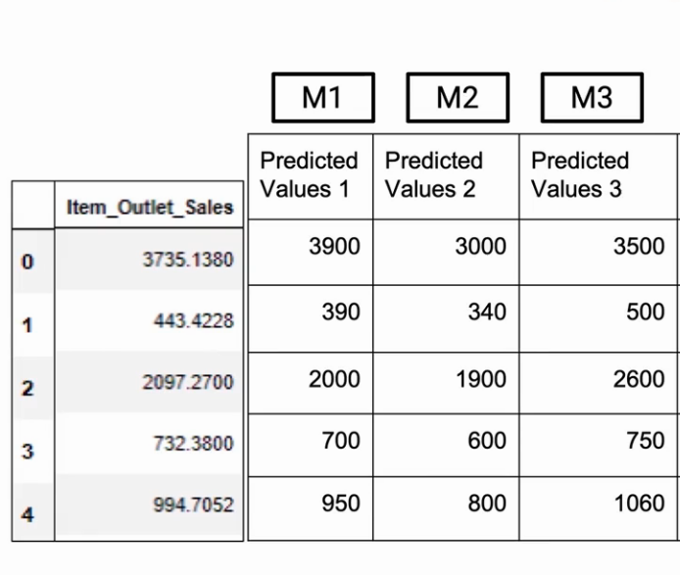
Lets say this is the data given for each model M1,M2 and M3.

Slide 10
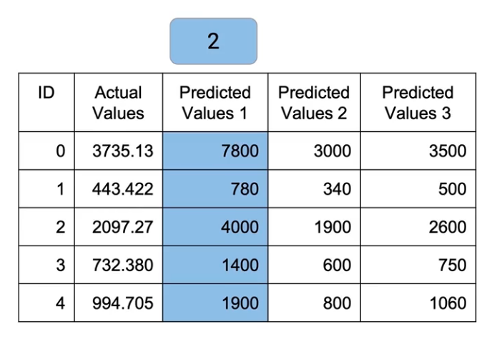
After Multiplying the values of M1 by 2

Slide 11
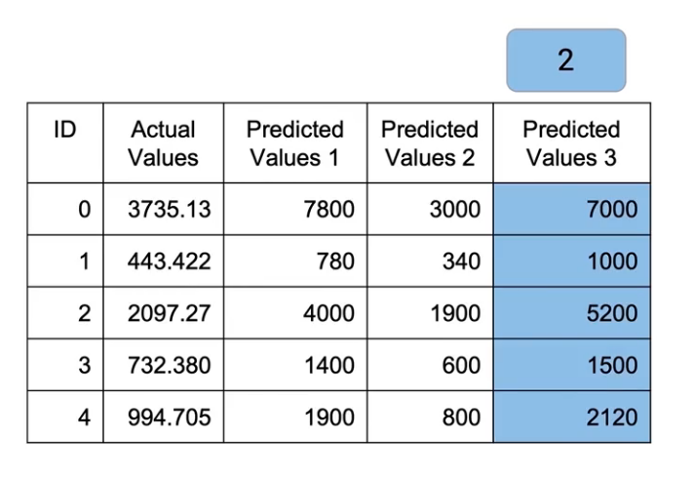
Similarly, We’ll multiply M2 by a factor of 1. So basically no values change there. And M3, we’ll multiply by a factor of 2 again,
n,

Slide 12
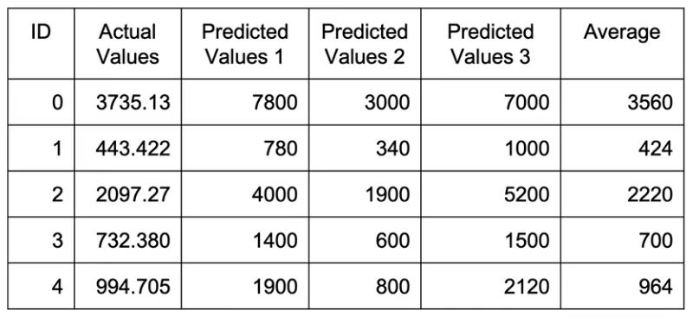
Now we take an average of all of these by dividing it by 5(2+1+2)
So what we have done is, taken weighted average from these models, but the weights were decided by us. That should give us better results(average values are closer to actual values) because we understand that these models work better and we have given them more weight.

